Slide 1
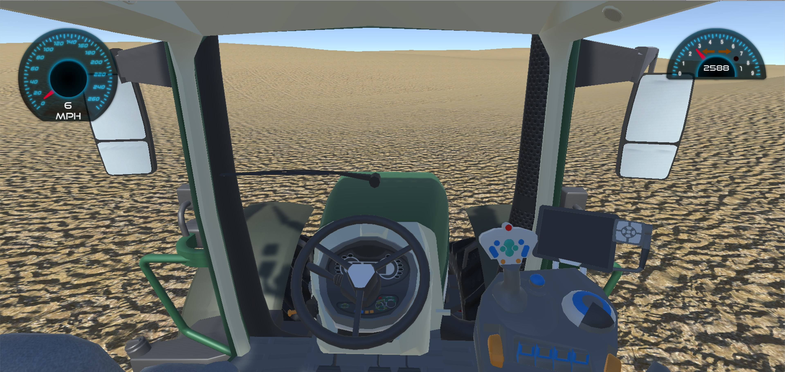
Precision Agriculture in Virtual Reality
Palouse virtual reality environment that simulates precision agriculture technologies

Slide 2

Precision Agriculture in Virtual Reality 2
Sponsor
Dev Shrestha
Team
Brad Whitesell
Chelsea Hogan
Joel Atwood

Slide 3

Project Objective
Create an immersive and realistic virtual reality experience that simulates the functionality of precision agriculture technologies.
Produce an engaging environment for teaching practical applications of precision agriculture technologies.

Slide 4

Design Goals
Develop a tractor console for navigation.
Define field boundaries for the virtual environment.
Design an algorithm for path optimization.
Visualize fertilization, top-soil runoff, and crop yield.

Slide 5
Value Proposition
Precision Agriculture is a modern crop management concept that utilizes emerging technologies to optimize return on investment, while reducing the cost in seed, fertilizer, fuel and time.
There is a need for an educational and promotional tool for showcasing and teaching practical applications of precision agriculture technologies.
To address this problem, we are developing an immersive and realistic virtual reality experience that simulates the functionality of these technologies.

Slide 6
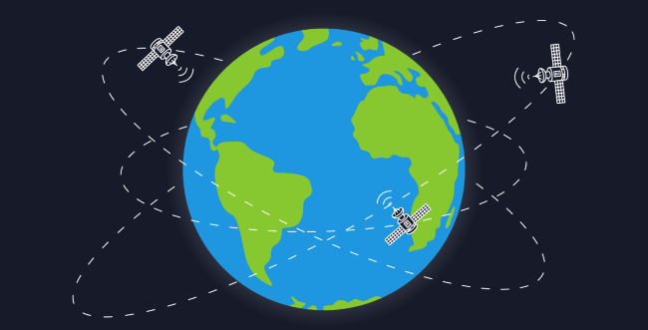


Project Learning
Precision Agriculture Technologies
Software Engineering Tools
Virtual Reality in Unity (C#)

Slide 7
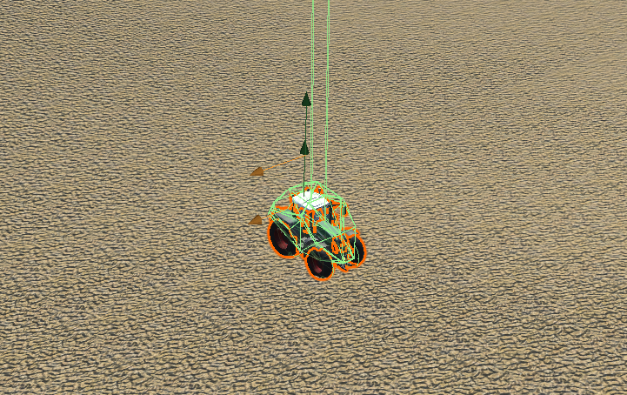
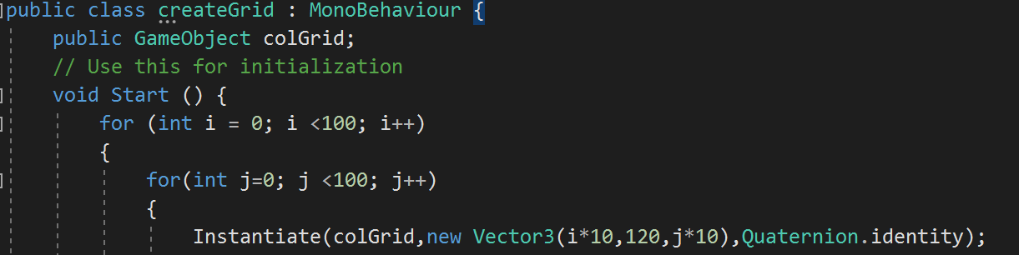
Development
Implemented Features
Realistic tractor control
Realistic terrain
Fertilization tracking and visualization
Developing Features
Tractor console navigation
Field boundaries
Crop yield tracking and visualization

Slide 8

Schedule
September
Value proposition
Field fertilization tracking and visualization
Field boundaries
October
Additional stat tracking
Add tractor console
Adjust movement physics
November
“GPS” console navigation
Console stat visualization
Field status variation
December
Possible path optimization
Code clean up and final presentation
Code hand-off

